Slide 1
Agile Development
Ollie Connett

Slide 2
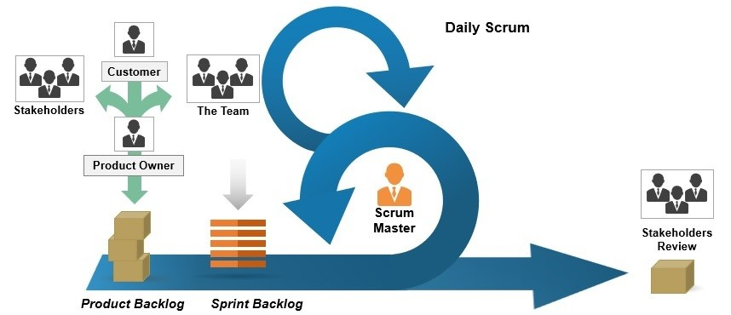
Roles In a Scrum-Agile Team
- Product Owner: The product owner is responsible for organizing the Product Backlog, creating user stories, and communicating with stackholders for feedback to share with the team.
-Scrum Master: The Scrum Master is in charge of guiding the team while maintaining Agile principles. They facilitate communication between all team members to ensure the team is on track.
- Developer/Team Member: The Developer is tasked with creating and delivering the plan for the project during each sprint interval

Slide 3
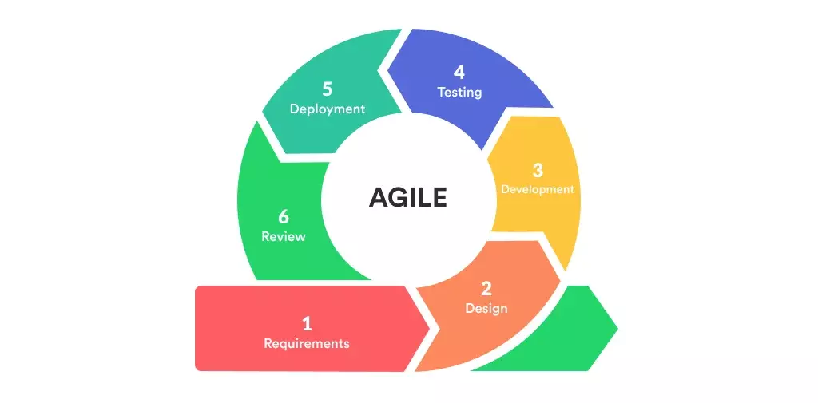
SDLC Phases in Agile
1. Requirements – User Stories are gathered from clients and stakeholders to share with the development team
2. Planning/Design - User stories are priotritized and estimated by the team to form sprint goals
3. Development / Execution – The Development team works on user stories to ensure all reaquirements are fulfilled
4. Testing - Project is tested to see if it runs correctly or if any bugs are present while running
5. Deployment - Developers prepare project as ready to use and delivered to customer
6. Review – Stakeholders provide feedback and team reflects on Sprint goals and areas for improvement

Slide 4
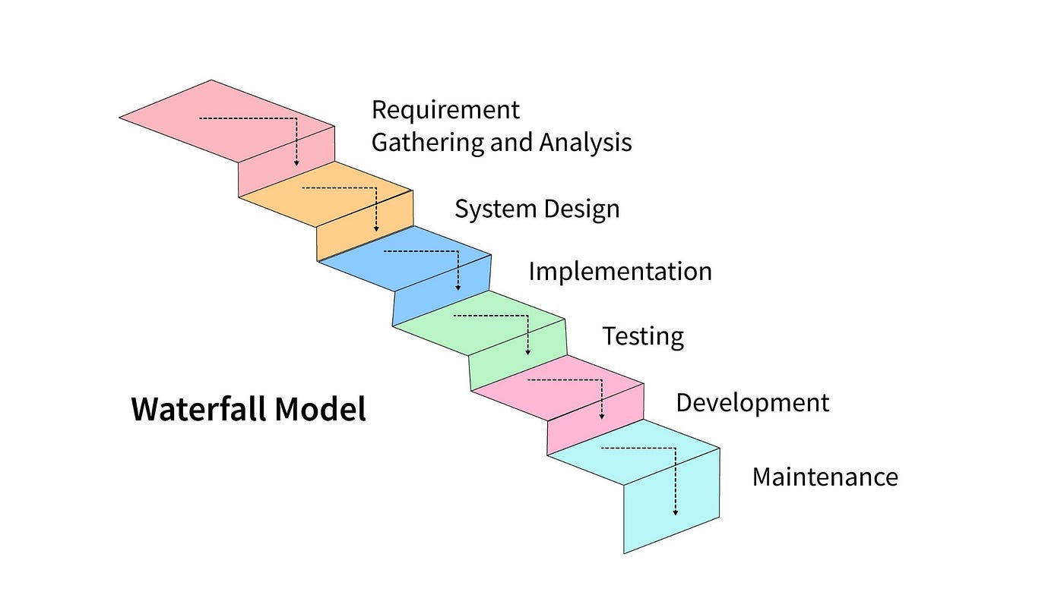
WAterfall
The Waterfall approach follows a linear development model that uses sequential stages with rigid requirments
Follows similar stages from Agile, but has little to no feedback from stakeholders
Waterfall is less adaptable to change. Once a stage is cleared, it is difficult to go back to fix or edit

Slide 5
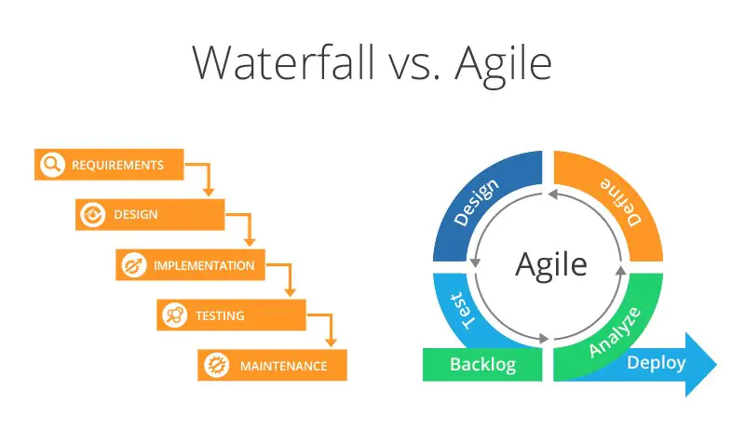
Which to Choose? Agile or Waterfall?
- Waterfall: Good for projects with well-defined parameters and stable processes, little to no stakeholder involvement, and low complexity, meaning that mistakes are not frequent during development.
- Agile: Best used for projects that involve changing requirements, high input/feedback from stakeholders, and a higher complexity as mistakes are made but can be fixed during development

Slide 6
References
Schwaber, K., & Sutherland, J. (2020). Scrum Guide | Scrum Guides. Scrumguides.org. https://scrumguides.org/scrum-guide.html#scrum-team
Singh, R. (2022, May 20). Waterfall Methodology. Institute of Project Management. https://instituteprojectmanagement.com/blog/waterfall-methodology/
Scrum.org. (2020). Accountability, Responsibility and Roles. Scrum.org. https://www.scrum.org/resources/accountability-responsibility-and-roles
Shultis, G. (2019, August 29). Agile vs. Waterfall: Pros & Cons, Use Cases, & More | Glasscubes. Glasscubes. https://www.glasscubes.com/agile-vs-waterfall/

